Slide 1
Component Specifications
Submitted by : Submitted to:Prof. Mike Aleshams
Gurvinder Singh
Ankit Patel
Krutika

Slide 2
Contents
LPC1769
MQ-2 Gas Sensor
50kg Load Cell Weight Sensor
HX711 Load cell amplifier and ADC
LTE Module
References

Slide 3
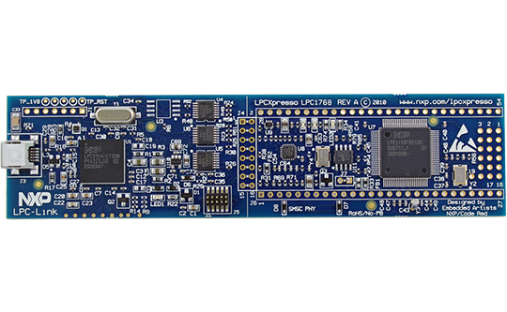
LPC1769

Slide 4
LPC1769 Overview
The LPC1769 is a Cortex-M3 microcontroller for embedded applications featuring a high level of integration and low power consumption at frequencies of 120 MHz. Features include 512 kB of flash memory, 64 kB of data memory, USB Device/Host/OTG, 8-channel DMA controller, 4 UARTs, 8-channel 12-bit ADC, 10-bit DAC, motor control PWM, Quadrature Encoder interface, 4 general purpose timers, ultra-low power Real-Time Clock with separate battery supply, and up to 70 general purpose I/O pins.

Slide 5
LPC1769 Specifications
LPC1769 LPCXpresso Board
Processor | NXP's Cortex-M3 LPC1769 microcontroller in LQFP100 package
Flash | 512 KByte
Data Memory | 64 KByte
Clock Crystals | 12.000 MHz crystal for CPU
Dimensions | 35 x 140 mm
Power | 3.15V-3.3V external powering, or from USB via JTAG probe (LPC-LINK)
Connectors | All LPC1769 pins available on expansion connector (2x27 pin rows, 100 mil pitch, 900 mil between rows)

Slide 6
Why we Use LPC1769 ?
On-board debugging circuit enables rapid prototyping and trouble shooting.
ARM Cortex-M3 architecture providing true real time behavior.
Already purchased and used previous semester so it will be cost effective.
Smaller footprint of LQFP100 package provides miniaturization during real product development.
Most importantly low power consumption (2 ma) during sleep mode.

Slide 7
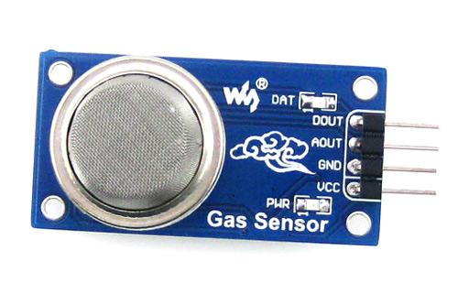
MQ-2 Gas Sensor

Slide 8
MQ-2 Gas Sensor
The MQ-2 Gas sensor can detect or measure gasses like LPG, Alcohol, Propane, Hydrogen, CO and even methane. The module version of this sensor comes with a Digital Pin which makes this sensor to operate even without a microcontroller and that comes in handy when you are only trying to detect one particular gas, hence can be used with most common microcontrollers.

Slide 9
MQ-2 Gas Sensor Specifications
Operating Voltage is +5V
Can be used to Measure or detect LPG, Alcohol, Propane, Hydrogen, CO and even methane
Analog output voltage: 0V to 5V
Digital Output Voltage: 0V or 5V (TTL Logic)
Preheat duration 20 seconds
Can be used as a Digital or analog sensor
The Sensitivity of Digital pin can be varied using the potentiometer

Slide 10
Why we Use MQ-2 Gas Sensor ?
It is system requirement to use any sensor which provides some triggering during the event of gas leakage.
MQ-2 class best suites to requirement as it can be utilized to measure multiple gases.
As it is very commonly available in market MTTR will be low if any failure during operation.

Slide 11
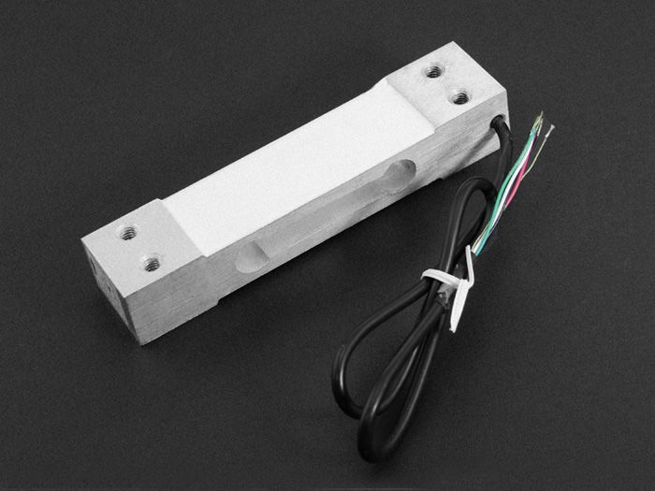
50kg Load Cell Weight Sensor
Applicable to electronic scale, price computing scale, electronic platform scale, digital scale, electronic balance and all varieties of commercial scales by single load cell.

Slide 12
50kg Load Cell Weight Sensor
Capacity: 50KG
Rated output(MV/V): 2.0±0.15
Maximum number of load cell verification intervals(N max): 2000
Minimum number of load cell verification intervals(V min): EMax/5000
Input resistance(Ω): 402±6
Output resistance(Ω): 350±3
Operating temperature range(°C): -35~+80
Safe overload(%RO): 150
Ultimate overload(%RO): 200
Load cell material: Aluminium
Method of connecting wire: Red(+),Black(-),Green(+),White(-)

Slide 13
Why we Used Load cell ?
Load cell converts surface stress in appropriate resistance value.
In this design it is required to use loadcell to measure weights and report ant changes in weight.
Sophisticated amplifiers are available in the market to be used with load cells.
Again availability and simple design helps to keep MTTR low.

Slide 14
HX711 :- 24-Bit ADC for Weight Scales
Features:-
• Two selectable differential input channels
• On-chip active low noise PGA with selectable gain of 32, 64 and 128
• On-chip power supply regulator for load-cell and ADC analog power supply
• On-chip oscillator requiring no external component with optional external crystal
• On-chip power-on-reset
• Simple digital control and serial interface: pin-driven controls, no programming needed
• Simultaneous 50 and 60Hz supply rejection
• Operation supply voltage range: 2.6 ~ 5.5V Current consumption including on-chip analog
power supply regulator: normal operation < 1.5mA, power down < 1uA
• Operation temperature range: -40 ~ +85°C
• 16 pin SOP-16 package.

Slide 15
Why we used HX711 ?
Low cost and widely available product.
Serves two function: Amplify and ADC.
Stable during wide temperature range.
Low power consumption (1 uA) during power down mode.

Slide 16
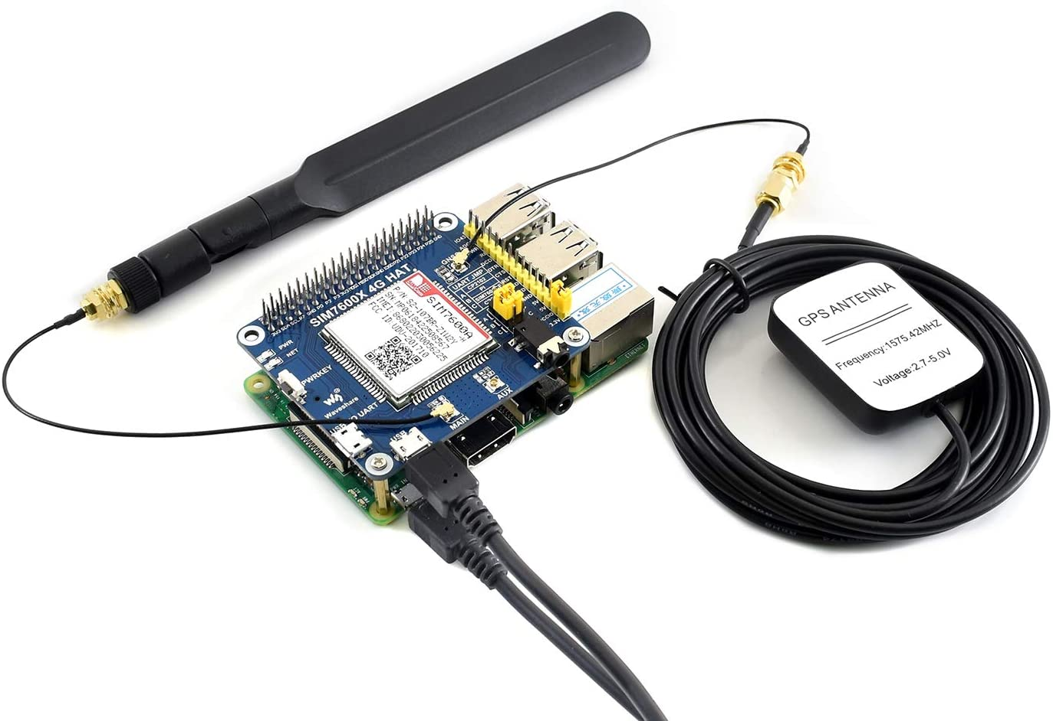
LTE Module
The SIM7600A-H 4G HAT is a 4G communication and GNSS positioning module, which supports LTE CAT4 up to 150Mbps for downlink data transfer at low power consumption.
You can connect this 4G module with computer to surf the Internet, or attach it onto Raspberry Pi to enable functions like 4G high speed connection, wireless communication, making telephone call, sending SMS, global positioning, etc.

Slide 17
LTE Module
Standard Raspberry Pi 40PIN GPIO extension header, supports Raspberry Pi series boards, Jetson Nano
Supports dial-up, telephone call, SMS, mail, TCP, UDP, DTMF, HTTP, FTP, etc.
Onboard USB interface, to test AT Commands, get GPS positioning data, and so on
Onboard CP2102 USB to UART converter, for serial debugging
Breakout UART control pins, to connect with host boards like Arduino/STM32
SIM card slot, supports 1.8V/3V SIM card
TF card slot for storing data like files, messages, etc.
Onboard audio jack and audio decoder for making telephone call
2x LED indicators, easy to monitor the working status
Onboard voltage translator, operating voltage can be configured to 3.3V or 5V via jumper
Baud rate : 300bps ~ 4Mbps (default: 115200bps)

Slide 18
LTE Module
Power supply: 5V
Operating voltage: 5V/3.3V (configured via jumper)
Operating temperature: -30°C ~ 80°C
Storage temperature: -45°C ~ 90°C
Dimension: 56.21mm x 65.15mm

Slide 19
Why we used LTE Module ?
To transfer measured weight data and gas sensor status to mobile application.
Now why using LTE module instead of GSM?
GSM(Sim 900a) | Sim(7600a)
Data Rate: DL- 85kbps, UL- 42kbps | Data Rate: DL- upto 150mbps, UL- upto 50mbps
Baud Rate: 1200bps to 115200bps | Baud Rate: 300bps to 4mbps
>Don’t have on-board USB-UART Interface >To connect MCU USB port it needs USB-UART convertor | >Have on-board USB-UART Interface >Easy to make direct connection between MCU USB port and Modem

Slide 20
Reference
1. LPC1769FBD100, Modified on March 20, 2020
https://www.nxp.com/products/processors-and-microcontrollers/arm-microcontrollers/general-purpose-mcus/lpc1700-cortex-m3/512kb-flash-64kb-sram-ethernet-usb-lqfp100-package:LPC1769FBD100
2. MQ2 Gas Sensor, modified on January 4, 2018
https://components101.com/mq2-gas-sensor
3. 50kg Load Cell Weight Sensor
https://www.seeedstudio.com/Weight-Sensor-Load-Cell-0-50kg-p-2099.html
4. 24-Bit ADC for Weight Scales
5. SIM7600CE-T/E-H/A-H/G-H 4G Modules, modified on May 26, 2020
https://www.waveshare.com/SIM7600A-H-4G-HAT.htm
https://cdn.sparkfun.com/datasheets/Sensors/ForceFlex/hx711_english.pdf

